Slide 1

Fall Seminar 2025
Diploma Years

Slide 2
College Research - Where do They want to go?
Xello!
Florida Shines - www.floridashines.org
Big Future Collegeboard - www.bigfuture.collegeboard.org
eCampus Tours - ecampustours.com
Admittedly - admitted.ly
Cappex - cappex.com
Chegg - chegg.com
College Raptor- collegeraptor.com
Is this college a good fit for me?
Do they have my major?
SAT?
ACT?
GPA?
LOCATION?
Is the price tag realistic?
What is their 4 year graduation rate?
What is their avg freshman retention rate?
Are there options for study abroad?
Are their students employed upon graduation?

Slide 3

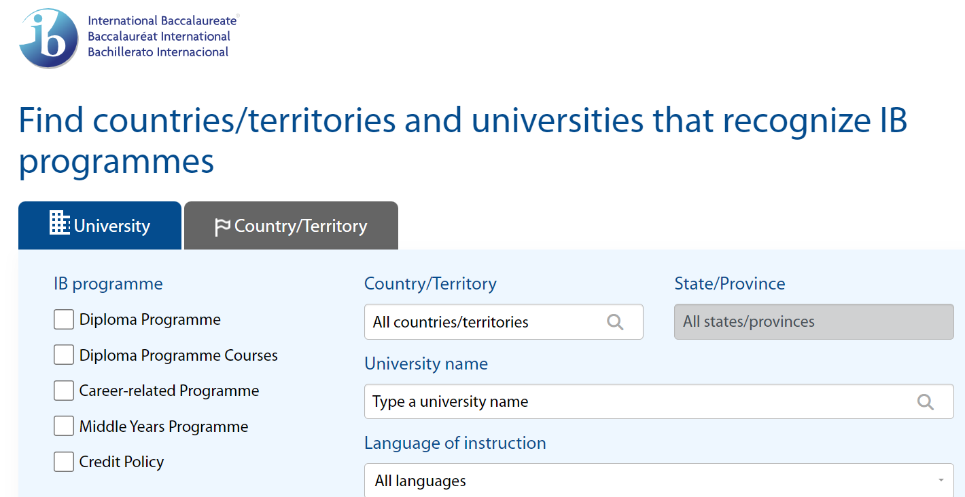
IB Resource to research colleges and the IB
https://recognition.ibo.org

Slide 4
School Day SAT
Seniors: Oct. 16th
^{Juniors: Spring -TBD}
**Everyone is automatically signed up!

Slide 5
SAT – collegeboard.org
2 sections
Scoring - range 200-800
Fee Waiver
Superscoring
Critical Reading & Writing
Math
800 max
total is 1600

Slide 6
ACT – act.org
4 sections
Scoring - Range
1-36
Each section gets scored
Composite = all sections averaged together
Super scoring
Fee Waiver
English, Math, Reading, Science
**Science is optional in 2025
Bright Futures will still require Science (as of right now)

Slide 7
Miscellaneous info
College days
College lists
Remind
Emails
Website, usernames, passwords
College Visits at PHU

Slide 8

BRIGHT FUTURES
Floridastudentfinancialaid.org
Application opens October 1st and ends at graduation

Slide 9
BRIGHT FUTURE SCHOLARSHIPS
FLORIDA ACADEMIC SCHOLARSHIP
FLORIDA MEDIALLION SCHOLARSHIP
3.5 GPA
29 ACT
1330 SAT
100 Hours
3.0 GPA
24 ACT
1190 SAT
75 hours
CAS – SERVICE will/can cover them for Bright Futures

Slide 10
IB Diploma
Bright Futures Academic Scholarship
Notes:
Shepherd-Thompson

Slide 11
The IB Core
Creativity-Activity-Service
Students MUST update Managebac by the 20th of each month
Theory of Knowledge
Extended Essay
Is your student on track?
Exhibition will be completed Junior Year
TOK Essay is in Senior Year
EE is started and worked on through TOK beginning in December of their Junior year and completed in Quarter 1 of their Senior year.
Notes:
Tancrell/Kluis

Slide 12
The IB Core - TOK
An interdisciplinary course that examines the nature of knowledge and the human capacity for thought and understanding
Critical is questioning how one knows what one claims to know; how does one properly justify that which is believed true
Students challenge their own held notions and underlying (unquestioned) assumptions
Address knowledge issues (AOKs)
Notes:
Tancrell/Kluis

Slide 13
The IB Core – CAS
Creativity-Activity-Service
Divided among the three strands
Planned (approved)
Experiences are carried out continuously for 18 months
Documented; evidenced
Signed off by an objective adult supervisor
Required interviews and reflection
Final review by IB CAS Coordinator
Notes:
Kluis

Slide 14
The IB Core Extended Essay
RESEARCH
INVESTIGATION
ACADEMIC INQUIRY
Reasoned examination of an intellectual nature in which established sources of academic merit are assessed and applied in the creation of authentic writing
Students have turned in their draft and should have arranged an appointment to receive feedback from their advisor
Once they’ve received feedback, revised and submitted final, they must meet with their advisor one last time for their Viva Voce
Notes:
Kluis

Slide 15

Critical Concept
CAS
TOK
EE
DP Courses
These are an integrated whole in developing ourselves with the attributes of the IB Learner Profile
Notes:
Tancrell/Kluis

Slide 16


Earning the IB Diploma
Palm Harbor University High School

Slide 17
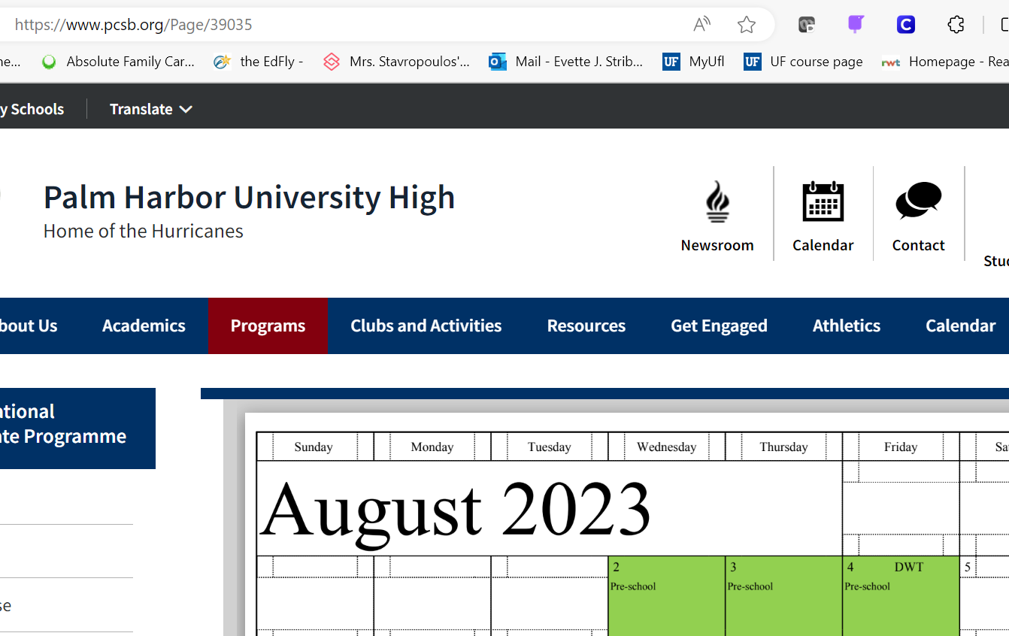
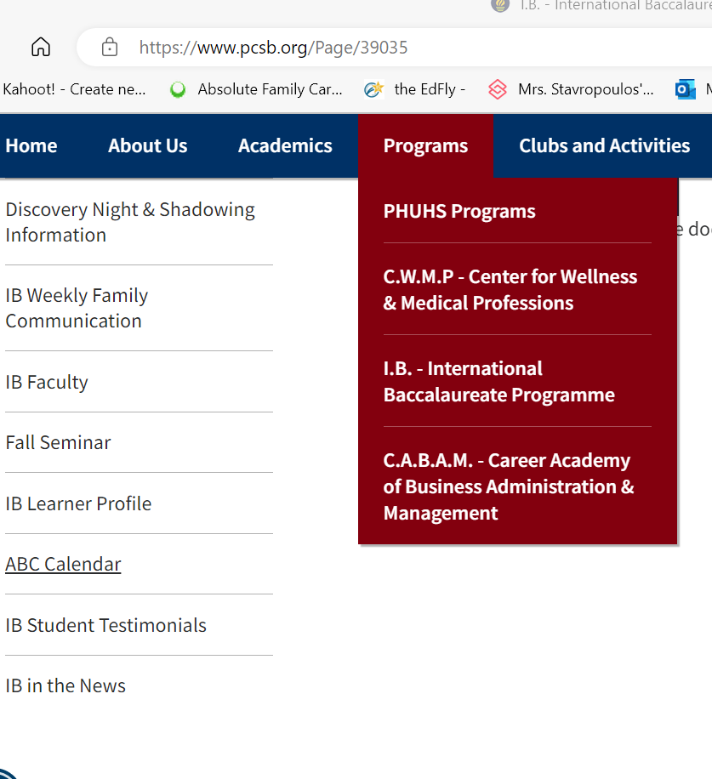
Important Dates: -Check Website ABC Calendar -Students have a packet with ALL IB DEADLINES for 25-26 & 26-27
Notes:
Striblen

Slide 18
The Diploma Years: Approaches to Teaching and Learning
View yourself as a college student
Bring your best game every day
Approaches to Teaching and Learning
Theoretical understanding to analyze and evaluate
Deep knowledge to put forth and debate assertions
Explain richly from divergent viewpoints
Notes:
Striblen

Slide 19
The Diploma Years: Approaches to Teaching and Learning
Study for depth of understanding and connections among concepts that may not immediately appear related
Each course is vital – You cannot sacrifice one for another
Managing your time is critical. Use a calendar and have a plan for all assignments and assessments
Notes:
Striblen

Slide 20
Internal vs. External Assessments in IB
Internal Assessments AKA IA
Structured within the classroom
Teacher guided
Teacher can only read the entirety of the paper ONE time and give feedback for revision
Likened to a research paper
Start in Junior year and end in Senior year
External Assessments AKA Papers
Taken outside of the classroom and proctored (like a state exam)
SL have 2; HL have 3
Paper 1, 2, 3
All are short and/or long written response
Exeption: Biology, Physics, and Chemistry have 1 multiple choice paper
Taken at the end of Senior year beginning the last week of April

Slide 21

Learning Goal
What are the regulations and score requirements for me to earn the IB Diploma?
Notes:
Striblen

Slide 22
What do you know?
What elements make up the Diploma calculation?
What is the score scale for IB courses?
What is the score scale for EE & TOK?
What’s the score in an IB course that puts a person out of the running for the Diploma?
What’s the score EE or TOK that puts a person out of the running for the Diploma?
Notes:
Striblen

Slide 23
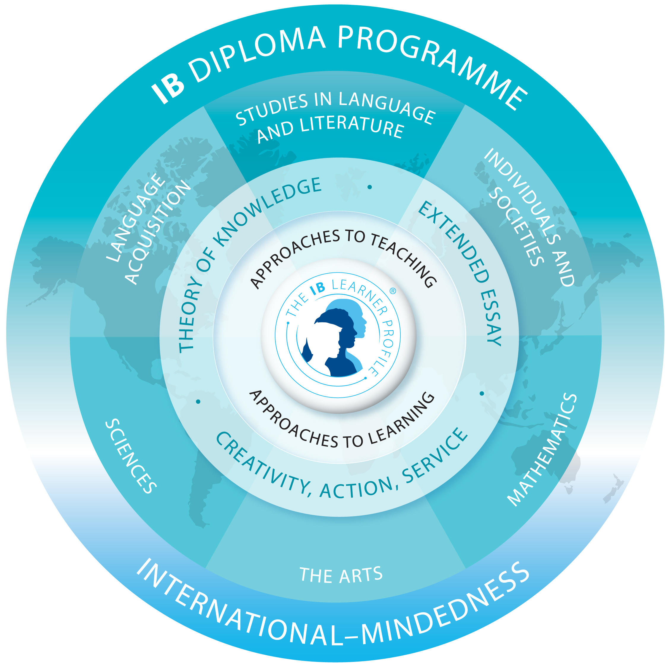
Earning the IB Diploma: Elements
All course and point requirements PLUS
You cannot earn the IB Diploma without
Theory of Knowledge
Extended Essay
CAS
Creativity-Activity-Service
These are also graduation requirements!
Notes:
Striblen

Slide 24
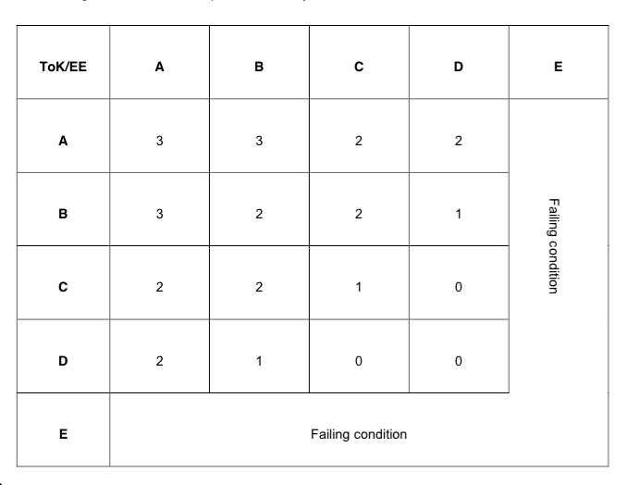
EE / TOK Matrix Bonus
TOK Exhibition & Paper
Extended Essay
(Source: IBO, Simplifying the Diploma Requirements 2014)
Notes:
Striblen

Slide 25
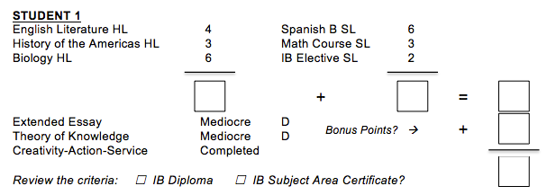
Student 1

Slide 26
Student 1
13
11
24
0
24
✔
Solution: IB Diploma

Slide 27
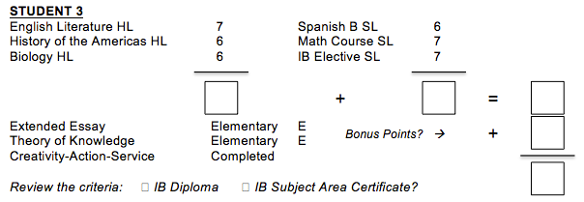
Student 2

Slide 28
Student 2
19
20
39
FC
39
✔
Solution: IB Subject Area Certificate (Failing Condition)

Slide 29
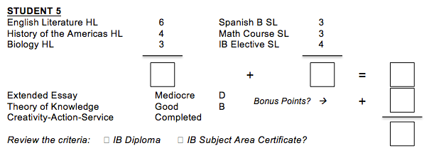
Student 3

Slide 30
Student 3
13
10
23
1
24
✔
Solution: IB Diploma

Slide 31
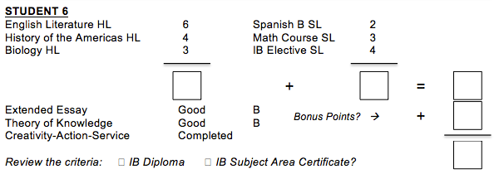
Student 4

Slide 32
Student 4
13
9
22
2
24
✔
Solution: IB Diploma

Slide 33
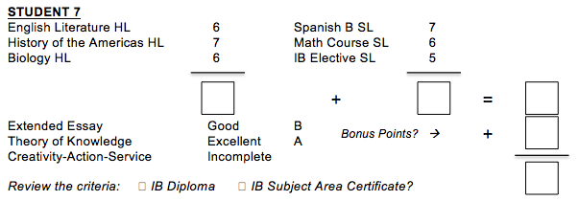
Student 5

Slide 34
Student 5
19
18
37
3
40
✔
Solution: IB Subject Area Certificate (CAS Not Met)

Slide 35
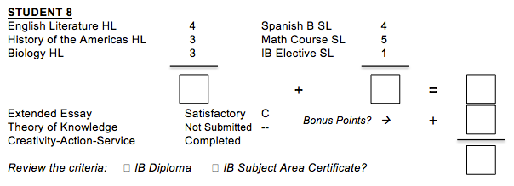
Student 6

Slide 36
Student 6
10
10
20
N
20
✔
Solution: IB Subject Area Certificate (<24 points N for TOK Score of 1)

Slide 37
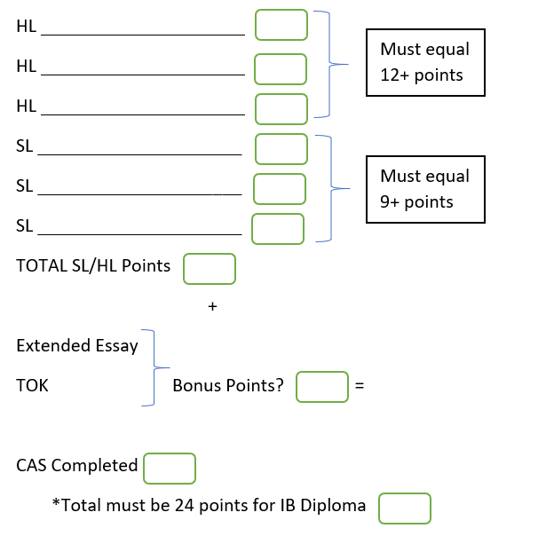
What about your student? Help them predict…
Notes:
Striblen

